Slide 1
Explore Cool Careers in Moray
STEM Resource Pack

Slide 2
Explore Cool Careers in Moray is an engaging and comprehensive STEM resource pack designed for young learners aged 3-12. This pack features activities that highlight the growth sectors within your locality, showcasing the diverse career opportunities available. Each activity not only promotes curiosity and hands-on learning but also outlines educational pathways and essential subjects for these high-demand roles.
Each activity is described in a step-by-step format to allow you, the teacher, to understand how to complete the activity for success. It is expected that you will adapt these guides based on your own knowledge of learners in your classroom – some may be able to follow the guide as is, others may benefit from your demonstration.
Lesson plans are designed to be easy to follow, containing all necessary background information on the relevant growth sector and careers associated with the sector and activity included. We have left space for you to design the lesson to suit the needs of your learners and your classroom environment. Where appropriate we have included worksheets and powerpoint presentations to help enable your lesson delivery.

Slide 3
Growth Sectors in Moray
Moray is home to several key growth sectors that drive the local economy and provide exciting career opportunities for young people. These include Aerospace, Creative Industries, Engineering and Construction, Manufacturing, Renewable Energy and Health and Life Sciences.
These industries are vital because they create high-value jobs, boost productivity, and help Moray remain a thriving and competitive region. By encouraging young people to pursue careers in these sectors, we can reduce brain drain, keeping talent local rather than losing skilled workers to other areas. This, in turn, strengthens the community, supports businesses, and ensures long-term economic growth.
By inspiring pupils to see the potential in these industries, we can help them build a successful future right here in Moray while contributing to the region’s prosperity.

Slide 4
Renewable Energy
About the sector and Moray

Slide 5

Background: Growth Sector
Moray is strategically positioned to become a significant contributor to Scotland's renewable energy goals. The region's abundant natural resources, particularly its wind and solar potential, are driving substantial growth in this sector. This expansion is not just about environmental sustainability; it's also about economic diversification and creating a robust, future-proof economy.
The development of large-scale offshore and onshore wind farms is a cornerstone of this growth. Projects like the Moray East Offshore Wind Farm are transforming the region's energy landscape, creating a demand for skilled workers and supporting a network of local businesses. Furthermore, the rising interest in green hydrogen production is utilising the wind power generated in the area, to further enhance the renewable energy sector.
Solar energy is also gaining traction, with companies like AES Solar leading the way in manufacturing and installing solar panels. The region's increasing adoption of solar technology is contributing to a more diversified renewable energy mix.
The Moray Growth Deal is also playing a role in this sector, as it is driving investment into infrastructure development, and skills training, to support the growth of the renewable energy sector. The creation of a skilled workforce is vital to ensure that Moray can capitalise on the opportunities presented by this rapidly expanding industry.
Moray is experiencing growth in renewable energy, driven by its natural resources and national energy transition goals. The region is well-suited for various renewable energy technologies.

Slide 6
Key players in Moray's renewable energy sector include
AES Solar:
  This company manufactures solar thermal and photovoltaic panels.
  They provide solar energy solutions for both residential and commercial applications.
  AES Solar is a significant local manufacturer in the renewable energy sector.
Wind Farm Developers and Operators
  Moray has several large-scale wind farms, both onshore and offshore.
  Companies involved in wind farm development and operation include those responsible for projects such as the Moray East Offshore Wind Farm.
  This also includes companies that provide maintenance for the turbines.
Companies involved in supporting infrastructure:
  There are also companies that provide support for the growing renewable energy sector, that provide services such as, electrical infrastructure, and grid connections.

Slide 7
Key aspects of the renewable energy sector in Moray
The region's abundant wind resources make it ideal for wind farm development, particularly offshore wind.
Solar energy is also a growing sector, with companies like AES Solar providing local manufacturing and installation expertise.
The area is involved in the generation of green hydrogen, and companies are looking to utilise the areas wind power to generate this.
The development of renewable energy projects is creating jobs in areas such as engineering, construction, and maintenance.
The infrastructure to support these projects, is also creating jobs.
Moray's renewable energy sector is contributing to the region's economic diversification and the UK's transition to a low-carbon economy.

Slide 8
Roles in the renewable energy sector in Moray
The renewable energy sector in Moray offers a wide range of high-value roles, spanning engineering, technical, and management positions. These roles are essential for the development, operation, and maintenance of renewable energy projects.
Wind Turbine Technician
These technicians install, maintain, and repair wind turbines, both onshore and offshore.
They perform routine inspections, troubleshoot faults, and ensure the safe and efficient operation of turbines.
Solar Panel Installer/Technician
These professionals install and maintain solar photovoltaic (PV) systems, ensuring they are properly configured and operating at optimal efficiency.
Electrical Engineer (Renewable Energy)
Electrical engineers design and develop electrical systems for renewable energy projects, including grid connections and power distribution.
Project Manager (Renewable Energy)
Project managers oversee the development and construction of renewable energy projects, ensuring they are completed on time and within budget.
Environmental Consultant
Environmental consultants assess the environmental impact of renewable energy projects and ensure compliance with environmental regulations.
Hydrogen production technician/engineer
These roles are crucial in the production of green hydrogen and involve the operation and maintenance of complex hydrogen generation systems.

Slide 9
Pathways into the renewable energy sector in Moray
There are several educational pathways into the renewable energy sector in Moray, catering to a range of educational backgrounds and career aspirations.
Foundation Apprenticeships
These apprenticeships provide senior phase secondary school pupils with a blend of classroom learning and practical work experience in renewable energy-related fields.
They offer a valuable introduction to the industry and provide a head start for
those considering a career in renewable energy.
Modern Apprenticeships
Modern Apprenticeships offer on-the-job training combined with formal qualifications, leading to skilled trades and technical roles in renewable energy.
Apprenticeships in areas such as electrical engineering, mechanical engineering, and renewable energy technologies are highly relevant.
College and University
Colleges and universities in Scotland offer a range of courses relevant to the renewable energy sector, including HNCs, HNDs, and degree programs in renewable energy engineering, electrical engineering, and environmental science.
These qualifications provide the theoretical foundation for advanced roles in renewable energy.

Slide 10
Subjects to study
These roles require a combination of technical skills, problem-solving abilities, and a commitment to environmental sustainability. The renewable energy sector in Moray is focused on attracting and retaining skilled professionals to fill these critical positions. Studying the following subjects will set pupils up for success.
National 4/5
Mathematics
Physics
Georgraphy
Technological Studies
Higher
Mathematics
Physics
Georgraphy
Engineering Science
Advanced Higher
Mathematics
Physics
Geography
Engineering Science

Slide 11
Lesson Plans
Early Years

Slide 12
Design a Working Water Wheel
Early Years

Slide 13
Renewable Energy: Water Wheel
Aim: To introduce young learners to the idea of moving water making things turn, just like old waterwheels and modern hydroelectric power. This lesson uses hands-on play to help children explore how water can create movement.
CfE Links
SCN 0-04a
TCH 0-12a
Learning Intentions
I will play with water and watch how it makes things move.
I will help to build a simple water wheel.
I will explore how people used water to help do work a long time ago.
Success Criteria
I can pour water and watch it make the wheel turn.
I can talk about how water pushes the wheel to move.
I can share my ideas about things that move with water today.

Slide 14

Renewable Energy: Water Wheel
Materials
Item | Quantity per group
Plastic Spoons | 10
Skewers | 1
Water Bucket | 1
Scissors | Shared
Measuring cup | 1
Stationary, e.g. pens and pencils, for decoration | Shared
Paper Plates | 2
Styrofoam Cylinder | 1
PVA Glue | 1

Slide 15
Renewable Energy: Water Wheel
Explain manufacturing means making things People and machines help make toys, clothes, food, and cars. A long time ago, people used big water wheels to help machines work. Now, we use electricity, but water still helps make power today. Show children a picture of a big waterwheel from an old factory (e.g., New Lanark). Ask: What do you think this big wheel does? How do you think it moves? Show a short video of a waterwheel turning. | See background information – Manufacturing / Renewable Energy BBC Two - Primary Focus Geography - Green Power, How does a water wheel work?
Activity 1: Make a water wheel (see activity notes) Young learners can colour, draw or paint the materials before you create the water wheel. Talk about what happens: What made it move? What happens if we pour more water? | (7) 5 Cool Facts About Hydro Power for Kids | What is Hydro Power? | How does Hydro Power Work? | Hydro - YouTube
Learning Intentions
I will construct and launch a water bottle rocket.​
I will investigate how air pressure and water create thrust.​
I will record observations, compare results, and refine my design.​
I will explore how engineers use moving water to generate electricity in hydroelectric power systems.
Success Criteria
I can describe how air pressure and water act as forces to launch my rocket.​
I can identify factors that affect the height and distance of my rocket.​
I can compare my results with my classmates and suggest improvements.​
I can connect my learning to real-world renewable energy systems, specifically hydroelectric power

Slide 16
Renewable Energy: Water Wheel
Explain how just like in the olden days, water still helps make factories work now – only now it’s from turbines or windmills underwater. Ask pupils to ‘windmill’ their arms – do they feel the air moving past their hands? Big underwater windmills do this with the water pushing them to make electricity. This is how we power factories today. Have pupils put their hands in water trays and ask them to push the water. How does it feel? Can they feel it pushing against their hands?
Reflection and discussion What did we see today? What made the wheel turn? Do we still use water for power? (Yes! Hydroelectric power stations use water to make electricity!) Where else do we see moving water? (Rivers, taps, rain, fountains) Take-Home Activity: Draw a picture of a waterwheel. Encourage children to use blue for water and brown for the wheel. Ask them to tell someone at home how the wheel moves.
Learning Intentions
I will construct and launch a water bottle rocket.​
I will investigate how air pressure and water create thrust.​
I will record observations, compare results, and refine my design.​
I will explore how engineers use moving water to generate electricity in hydroelectric power systems.
Success Criteria
I can describe how air pressure and water act as forces to launch my rocket.​
I can identify factors that affect the height and distance of my rocket.​
I can compare my results with my classmates and suggest improvements.​
I can connect my learning to real-world renewable energy systems, specifically hydroelectric power

Slide 17
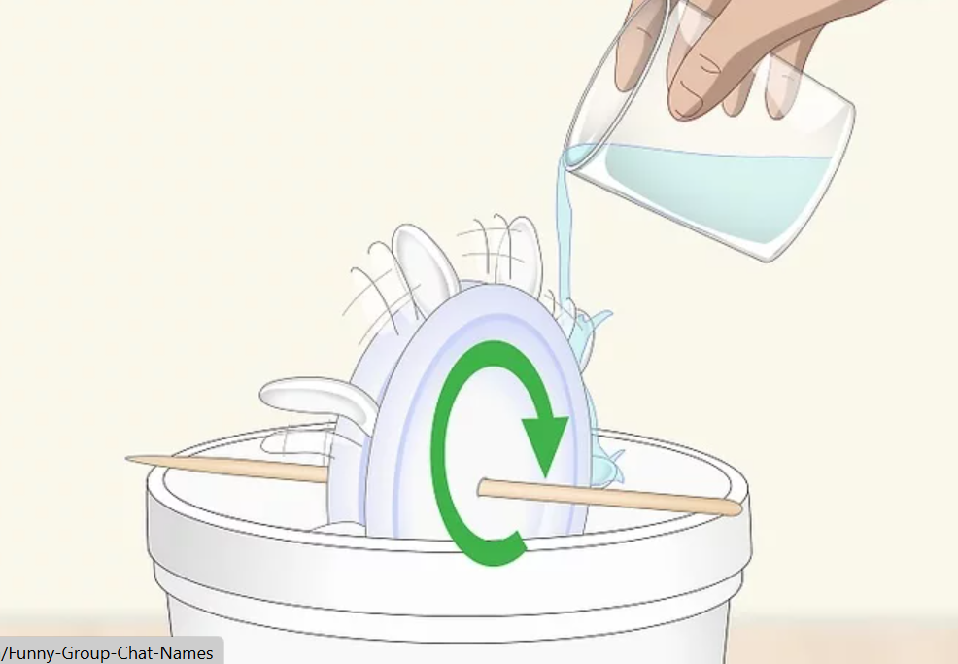
Renewable Energy: Water Wheel
Use scissors to cut 10 plastic spoons in half at an angle. The spoons will serve as the paddles that actually turn the wheel when water passes over them.
Cut a circle with a diameter equal to the length of a spoon. Lay one of the spoons you cut down on the styrofoam and draw a circle around it so the diameter of the circle is about as wide as your spoons.
Insert the spoons into the outside edge of the styrofoam. Push the cut edge of the spoons you cut into the styrofoam until about 1 inch (2.5 cm) of the handle and the bowl of the spoon are exposed.
Use a pencil to mark the center of 2 paper plates and your foam circle. It’s important that your skewer goes through the center of your wheel to ensure that it turns properly.
Make a hole in the center with a wooden skewer. Once you’ve found your center points, use a skewer to make a hole by pushing it through the center of the plates and the foam
Glue the plates to the sides of the foam disk. The 2 paper plates will serve to stabilize the foam disk and the spoons.
Push the skewer through the center of the wheel.
Set your wheel on a bucket and fill a glass with water.
Slowly pour the water onto the spoons to turn the wheel
Learning Intentions
I will construct and launch a water bottle rocket.​
I will investigate how air pressure and water create thrust.​
I will record observations, compare results, and refine my design.​
I will explore how engineers use moving water to generate electricity in hydroelectric power systems.
Success Criteria
I can describe how air pressure and water act as forces to launch my rocket.​
I can identify factors that affect the height and distance of my rocket.​
I can compare my results with my classmates and suggest improvements.​
I can connect my learning to real-world renewable energy systems, specifically hydroelectric power

Slide 18
Explainers: Terms used
Level One

Slide 19
Explainer: Hydropower
Hydroelectric power, or hydropower, is basically using the flow of water to make electricity.
Here's a simple breakdown
Water's potential: Up in the hills, where it rains a lot, water is collected and stored in a reservoir, like a big man-made lake. This water has potential energy because it's high up.
Letting it flow: The water is then released and flows downhill through pipes called penstocks.
Turning a turbine: As the water rushes down, it spins a turbine, which is like a big water wheel.
Generating electricity: The spinning turbine turns a generator, which converts the kinetic energy (the energy of movement) into electricity.
Sending it out: That electricity is then sent out through power lines to homes and businesses.
So, in short, it's about using gravity to make water spin a turbine, which then makes electricity.

Slide 20
Explainer: Manufacturing
What is Manufacturing? Manufacturing is how we make things
Factories use big machines and people working together to make toys, clothes, food, and even cars. Instead of one person making everything, each worker or machine does a small job, like putting a wheel on a car or wrapping a chocolate bar.
Example: Imagine making 100 sandwiches. If one person does everything alone, it takes a long time. But if one person spreads the butter, another adds the cheese, and someone else puts it in a box, we finish much faster. That’s how factories work

Slide 21
Explainer: Manufacturing
What is Manufacturing? Manufacturing is how we make things
Factories use big machines and people working together to make toys, clothes, food, and even cars. Instead of one person making everything, each worker or machine does a small job, like putting a wheel on a car or wrapping a chocolate bar.
Example: Imagine making 100 sandwiches. If one person does everything alone, it takes a long time. But if one person spreads the butter, another adds the cheese, and someone else puts it in a box, we finish much faster. That’s how factories work

Slide 22
Explainer: Hydropower in Manufacturing
Waterwheels in Manufacturing (Then)
In the past, factories were built next to rivers. Moving water turned a big wheel, which spun gears inside the factory. These gears powered machines for making cloth, grinding grain, or cutting wood.
One of Scotland’s most famous water-powered mills was New Lanark, which made textiles using only water energy.
Hydroelectric Power in Manufacturing (Now)
Today, water still powers factories and manufacturers, but instead of a waterwheel, we use hydroelectric power stations. These stations work like giant waterwheels, but instead of turning gears, they turn turbines that create electricity.
Some manufacturing companies in Scotland use renewable hydro power to reduce pollution. Examples include:
• Smurfit Kappa (paper production using hydropower)
• Alvance British Aluminium (uses hydropower in Lochaber)
So even though waterwheels are no longer used in factories, water is still powering manufacturing today

