Slide 1
Explore Cool Careers in Moray
STEM Resource Pack

Slide 2
Explore Cool Careers in Moray is an engaging and comprehensive STEM resource pack designed for young learners aged 3-12. This pack features 15 activities that highlight the growth sectors within your locality, showcasing the diverse career opportunities available. Each activity not only promotes curiosity and hands-on learning but also outlines educational pathways and essential subjects for these high-demand roles.
Each activity is described in a step-by-step format to allow you, the teacher, to understand how to complete the activity for success. It is expected that you will adapt these guides based on your own knowledge of learners in your classroom – some may be able to follow the guide as is, others may benefit from your demonstration.
Lesson plans are designed to be easy to follow, containing all necessary background information on the relevant growth sector and careers associated with the sector and activity included. We have left space for you to design the lesson to suit the needs of your learners and your classroom environment. Where appropriate we have included worksheets and powerpoint presentations to help enable your lesson delivery.

Slide 3
Growth Sectors in Moray
Moray is home to several key growth sectors that drive the local economy and provide exciting career opportunities for young people. These include Aerospace, Creative Industries, Engineering and Construction, Manufacturing, Renewable Energy and Health and Life Sciences.
These industries are vital because they create high-value jobs, boost productivity, and help Moray remain a thriving and competitive region. By encouraging young people to pursue careers in these sectors, we can reduce brain drain, keeping talent local rather than losing skilled workers to other areas. This, in turn, strengthens the community, supports businesses, and ensures long-term economic growth.
By inspiring pupils to see the potential in these industries, we can help them build a successful future right here in Moray while contributing to the region’s prosperity.

Slide 4
Renewable Energy
About the sector and Moray

Slide 5

Background: Growth Sector
Moray is strategically positioned to become a significant contributor to Scotland's renewable energy goals. The region's abundant natural resources, particularly its wind and solar potential, are driving substantial growth in this sector. This expansion is not just about environmental sustainability; it's also about economic diversification and creating a robust, future-proof economy.
The development of large-scale offshore and onshore wind farms is a cornerstone of this growth. Projects like the Moray East Offshore Wind Farm are transforming the region's energy landscape, creating a demand for skilled workers and supporting a network of local businesses. Furthermore, the rising interest in green hydrogen production is utilising the wind power generated in the area, to further enhance the renewable energy sector.
Solar energy is also gaining traction, with companies like AES Solar leading the way in manufacturing and installing solar panels. The region's increasing adoption of solar technology is contributing to a more diversified renewable energy mix.
The Moray Growth Deal is also playing a role in this sector, as it is driving investment into infrastructure development, and skills training, to support the growth of the renewable energy sector. The creation of a skilled workforce is vital to ensure that Moray can capitalise on the opportunities presented by this rapidly expanding industry.
Moray is experiencing growth in renewable energy, driven by its natural resources and national energy transition goals. The region is well-suited for various renewable energy technologies.

Slide 6
Key players in Moray's renewable energy sector include
AES Solar:
  This company manufactures solar thermal and photovoltaic panels.
  They provide solar energy solutions for both residential and commercial applications.
  AES Solar is a significant local manufacturer in the renewable energy sector.
Wind Farm Developers and Operators
  Moray has several large-scale wind farms, both onshore and offshore.
  Companies involved in wind farm development and operation include those responsible for projects such as the Moray East Offshore Wind Farm.
  This also includes companies that provide maintenance for the turbines.
Companies involved in supporting infrastructure:
  There are also companies that provide support for the growing renewable energy sector, that provide services such as, electrical infrastructure, and grid connections.

Slide 7
Key aspects of the renewable energy sector in Moray
The region's abundant wind resources make it ideal for wind farm development, particularly offshore wind.
Solar energy is also a growing sector, with companies like AES Solar providing local manufacturing and installation expertise.
The area is involved in the generation of green hydrogen, and companies are looking to utilise the areas wind power to generate this.
The development of renewable energy projects is creating jobs in areas such as engineering, construction, and maintenance.
The infrastructure to support these projects, is also creating jobs.
Moray's renewable energy sector is contributing to the region's economic diversification and the UK's transition to a low-carbon economy.

Slide 8
Roles in the renewable energy sector in Moray
The renewable energy sector in Moray offers a wide range of high-value roles, spanning engineering, technical, and management positions. These roles are essential for the development, operation, and maintenance of renewable energy projects.
Wind Turbine Technician
These technicians install, maintain, and repair wind turbines, both onshore and offshore.
They perform routine inspections, troubleshoot faults, and ensure the safe and efficient operation of turbines.
Solar Panel Installer/Technician
These professionals install and maintain solar photovoltaic (PV) systems, ensuring they are properly configured and operating at optimal efficiency.
Electrical Engineer (Renewable Energy)
Electrical engineers design and develop electrical systems for renewable energy projects, including grid connections and power distribution.
Project Manager (Renewable Energy)
Project managers oversee the development and construction of renewable energy projects, ensuring they are completed on time and within budget.
Environmental Consultant
Environmental consultants assess the environmental impact of renewable energy projects and ensure compliance with environmental regulations.
Hydrogen production technician/engineer
These roles are crucial in the production of green hydrogen and involve the operation and maintenance of complex hydrogen generation systems.

Slide 9
Pathways into the renewable energy sector in Moray
There are several educational pathways into the renewable energy sector in Moray, catering to a range of educational backgrounds and career aspirations.
Foundation Apprenticeships
These apprenticeships provide senior phase secondary school pupils with a blend of classroom learning and practical work experience in renewable energy-related fields.
They offer a valuable introduction to the industry and provide a head start for
those considering a career in renewable energy.
Modern Apprenticeships
Modern Apprenticeships offer on-the-job training combined with formal qualifications, leading to skilled trades and technical roles in renewable energy.
Apprenticeships in areas such as electrical engineering, mechanical engineering, and renewable energy technologies are highly relevant.
College and University
Colleges and universities in Scotland offer a range of courses relevant to the renewable energy sector, including HNCs, HNDs, and degree programs in renewable energy engineering, electrical engineering, and environmental science.
These qualifications provide the theoretical foundation for advanced roles in renewable energy.

Slide 10
Subjects to study
These roles require a combination of technical skills, problem-solving abilities, and a commitment to environmental sustainability. The renewable energy sector in Moray is focused on attracting and retaining skilled professionals to fill these critical positions. Studying the following subjects will set pupils up for success.
National 4/5
Mathematics
Physics
Georgraphy
Technological Studies
Higher
Mathematics
Physics
Georgraphy
Engineering Science
Advanced Higher
Mathematics
Physics
Geography
Engineering Science

Slide 11
Lesson Plans
Level One

Slide 12
Design a Working Water Wheel
Level One

Slide 13
Renewable Energy: Water Wheel
Aim: To explore how water power has been used in manufacturing, from early factories powered by waterwheels to modern hydroelectric power stations. Pupils will learn how water energy is used today as a renewable energy source to power industries.
CfE Links
SCN 1-04a
TCH 1-12a
Learning Intentions
I will learn how factories in the past used waterwheels to power machines.
I will explore how hydroelectric power is used today in manufacturing.
I will design and build a working waterwheel to test how water can create movement.
Success Criteria
I can explain how a waterwheel works.
I can describe how water energy powered early factories.
I can explain how hydroelectric power is used today to provide energy for factories and manufacturers.

Slide 14
Renewable Energy: Water Wheel
Materials
Item | Quantity per group
Plastic Spoons | 10
Skewers | 1
Water Bucket | 1
Scissors | Shared
Measuring cup | 1
Stationary, e.g. pens and pencils, for decoration | Shared
Paper Plates | 2
Styrofoam Cylinder | 1
PVA Glue | 1

Slide 15
Renewable Energy: Water Wheel
Explain how factories used water power to move machines before electricity. Show pictures of old Scottish watermills Explain that a waterwheel uses moving water to turn paddles, which powers machines. A waterwheel turns when water flows over it. This spinning movement powered machines in factories before electricity was invented. | See background information – Manufacturing BBC Two - Primary Focus Geography - Green Power, How does a water wheel work?
Explain changes in factories from 1800 – date, show differences between New Lanark and the lego factory. Explain that waterwheels still play a large part in powering factories and other types of manufacturing, only this time instead it is through hydro electric power. | (7) 5 Cool Facts About Hydro Power for Kids | What is Hydro Power? | How does Hydro Power Work? | Hydro - YouTube
Demonstrate how to build a water wheel Explain how filling the buckets is moving the wheel and relate to hydro electric power Pupils construct their water wheels | Pupil worksheet
Learning Intentions
I will construct and launch a water bottle rocket.​
I will investigate how air pressure and water create thrust.​
I will record observations, compare results, and refine my design.​
I will explore how engineers use moving water to generate electricity in hydroelectric power systems.
Success Criteria
I can describe how air pressure and water act as forces to launch my rocket.​
I can identify factors that affect the height and distance of my rocket.​
I can compare my results with my classmates and suggest improvements.​
I can connect my learning to real-world renewable energy systems, specifically hydroelectric power

Slide 16
Renewable Energy: Water Wheel
Pupils work in teams to build a mini waterwheel using spoons and a cardboard wheel. Pupils pour water over their wheel and observe. Does it spin? Does it need improvement? Explain how engineers test and improve designs. Pupils make changes (e.g., larger paddles, better balance) to see if it improves their waterwheel. Pupils retest their improved waterwheel and compare results. Pupils complete the activity using materials provided and collect results on the pupil worksheet. | Pupil worksheet
Reflection and discussion Pupils compare their findings Which team improved the most? What changes helped? Factories no longer use waterwheels, but they still use water power. Hydroelectric power stations use the same idea, but now they generate electricity to power modern manufacturing.
Learning Intentions
I will construct and launch a water bottle rocket.​
I will investigate how air pressure and water create thrust.​
I will record observations, compare results, and refine my design.​
I will explore how engineers use moving water to generate electricity in hydroelectric power systems.
Success Criteria
I can describe how air pressure and water act as forces to launch my rocket.​
I can identify factors that affect the height and distance of my rocket.​
I can compare my results with my classmates and suggest improvements.​
I can connect my learning to real-world renewable energy systems, specifically hydroelectric power

Slide 17
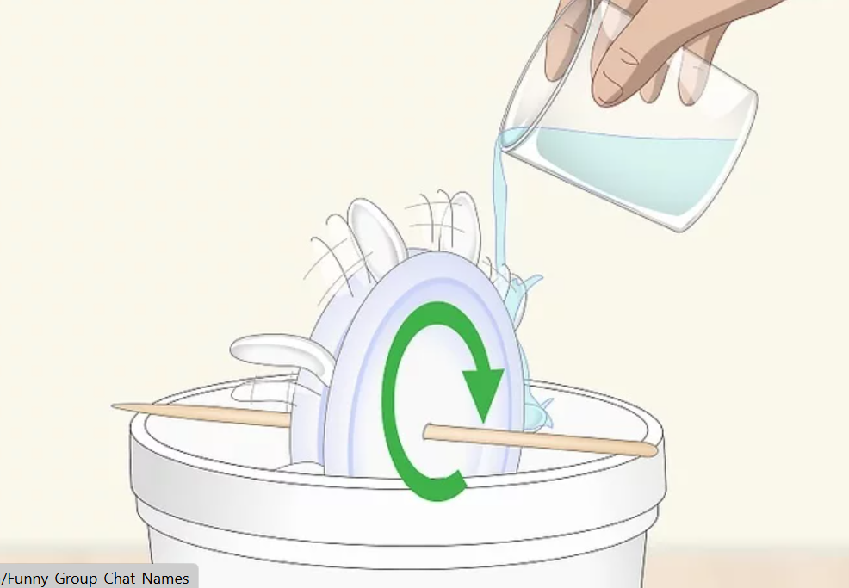
Renewable Energy: Water Wheel
Use scissors to cut 10 plastic spoons in half at an angle. The spoons will serve as the paddles that actually turn the wheel when water passes over them.
Cut a circle with a diameter equal to the length of a spoon. Lay one of the spoons you cut down on the styrofoam and draw a circle around it so the diameter of the circle is about as wide as your spoons.
Insert the spoons into the outside edge of the styrofoam. Push the cut edge of the spoons you cut into the styrofoam until about 1 inch (2.5 cm) of the handle and the bowl of the spoon are exposed.
Use a pencil to mark the center of 2 paper plates and your foam circle. It’s important that your skewer goes through the center of your wheel to ensure that it turns properly.
Make a hole in the center with a wooden skewer. Once you’ve found your center points, use a skewer to make a hole by pushing it through the center of the plates and the foam
Glue the plates to the sides of the foam disk. The 2 paper plates will serve to stabilize the foam disk and the spoons.
Push the skewer through the center of the wheel.
Set your wheel on a bucket and fill a glass with water.
Slowly pour the water onto the spoons to turn the wheel
Learning Intentions
I will construct and launch a water bottle rocket.​
I will investigate how air pressure and water create thrust.​
I will record observations, compare results, and refine my design.​
I will explore how engineers use moving water to generate electricity in hydroelectric power systems.
Success Criteria
I can describe how air pressure and water act as forces to launch my rocket.​
I can identify factors that affect the height and distance of my rocket.​
I can compare my results with my classmates and suggest improvements.​
I can connect my learning to real-world renewable energy systems, specifically hydroelectric power

Slide 18
Power Lines
Level One

Slide 19
Renewable Energy: Power Lines
Aim: To introduce primary pupils to the basics of power generation and energy transmission, and develop their understanding through a practical model-building activity.
CfE Links
SCN 1-07a
TCH 1-09a
Learning Intentions
Understand that electricity is generated at power stations
Discover how electricity travels from power stations to homes and schools
Explore different types of energy generation (renewable and non-renewable)
Design and build a simple model of power lines
Success Criteria
I can explain where electricity comes from
I can describe how electricity gets from power stations to our homes
I can name at least two different ways to generate electricity
I can build a model of power lines using simple materials
I can make decisions about materials based on a budget

Slide 20
Renewable Energy: Power Lines
Materials
Item | Quantity per group
Lollipop Sticks | 40
Blu Tac | 1
String | 1
Sellotape | 1
Paper Clips | 40
Worksheet | 1

Slide 21
Renewable Energy: Power Lines
Ask: Where does electricity come from? Record pupils' ideas on the board. Ask: How does electricity get to our homes? Tell: Today we're going to learn about how electricity is made and how it travels to our homes. Show images of different power generation methods. | See background information – Renewable Energy What is renewable and non-renewable energy? - BBC Bitesize
Show: Video clip about electricity generation and transmission. Ask: "What different ways did you see electricity being made? Talk about renewable and non renewable sources of energy, ask pupils to name them and guess how they work. Ask pupils to draw how they think a renewable energy source (like wind) gets from the turbine to our homes. Explain the journey of electricity to our homes. | KS1 / KS2 Science: How is electricity made? - BBC Bitesize See explainers Where does electricity come from? | The journey of electricity to your home | National Grid Group
Learning Intentions
I will construct and launch a water bottle rocket.​
I will investigate how air pressure and water create thrust.​
I will record observations, compare results, and refine my design.​
I will explore how engineers use moving water to generate electricity in hydroelectric power systems.
Success Criteria
I can describe how air pressure and water act as forces to launch my rocket.​
I can identify factors that affect the height and distance of my rocket.​
I can compare my results with my classmates and suggest improvements.​
I can connect my learning to real-world renewable energy systems, specifically hydroelectric power

Slide 22
Renewable Energy: Power Lines
Pupils should now complete the power lines activity with as much support as needed. Explain to pupils that getting the energy from where it comes from (wind, see, etc) to our houses or school costs money. They should design the best power line they can but not spend more money on the project than they have been given. This should first be drawn of paper before building models. | Pupil worksheet Materials
Reflection and discussion Ask learners what went well and what they might change next time? Lead learners in a discusson about what we learned today, ask for a new fun fact about electricity and how it gets from a turbine to our houses.
Learning Intentions
I will construct and launch a water bottle rocket.​
I will investigate how air pressure and water create thrust.​
I will record observations, compare results, and refine my design.​
I will explore how engineers use moving water to generate electricity in hydroelectric power systems.
Success Criteria
I can describe how air pressure and water act as forces to launch my rocket.​
I can identify factors that affect the height and distance of my rocket.​
I can compare my results with my classmates and suggest improvements.​
I can connect my learning to real-world renewable energy systems, specifically hydroelectric power

Slide 23
Renewable Energy: Power Lines
Challenge: Build a model of Power Lines that can carry electricity (represented by string) from a power station to homes.
Criteria: Your power line must: Budget: Your team has 25 points to spend
Stand up by itself Choose your materials wisely
Be at least 10cm tall
Carry the string without touching the ground
Connect at least 3 “pylons” (supports)
Learning Intentions
I will construct and launch a water bottle rocket.​
I will investigate how air pressure and water create thrust.​
I will record observations, compare results, and refine my design.​
I will explore how engineers use moving water to generate electricity in hydroelectric power systems.
Success Criteria
I can describe how air pressure and water act as forces to launch my rocket.​
I can identify factors that affect the height and distance of my rocket.​
I can compare my results with my classmates and suggest improvements.​
I can connect my learning to real-world renewable energy systems, specifically hydroelectric power
Materials Available
Material | What it represents | Cost (points)
Lolly stick | Support beam | 2 points each
Blue tack | Foundation/base | 1 point per small ball
String | Electrical wires | 5 points per meter
Sellotape | Connectors | 3 points per 10 cm piece
Paper clip | Cable support | 2 points each

Slide 24
Renewable Energy: Power Lines
Planning Sheet:
Draw your design first
List what materials you need
Calculate the total cost
Get teacher approval before collecting materials
Building Tips:
Make sure your pylons (supports) have a strong base
The string (power lines) should be tight but not too tight
Space your pylons evenly
Think about how real power lines look
Testing:
Your power line model will be tested by:
Measuring its height
Checking if it stands without support
Making sure the string doesn't touch the ground
Seeing if it can stay standing for at least 1 minute
Extensions Activities:
If you finish early, try to:
Add a "substation" to your model (a small box made from paper)
Create branches of power lines going to different "homes"
Add small flags or signs explaining what different parts represent
Learning Intentions
I will construct and launch a water bottle rocket.​
I will investigate how air pressure and water create thrust.​
I will record observations, compare results, and refine my design.​
I will explore how engineers use moving water to generate electricity in hydroelectric power systems.
Success Criteria
I can describe how air pressure and water act as forces to launch my rocket.​
I can identify factors that affect the height and distance of my rocket.​
I can compare my results with my classmates and suggest improvements.​
I can connect my learning to real-world renewable energy systems, specifically hydroelectric power

Slide 25
Towering Turbines
Level One

Slide 26
Renewable Energy: Towering Turbines
Aim: To introduce pupils to wind turbines, how they work, and how they help us use clean, renewable energy from the wind.
CfE Links
SCN 1-04a
SCN 1-20a
Learning Intentions
We are learning about how wind can create energy.
We are learning how wind turbines help protect the planet.
We are learning how to build a simple wind turbine model.
Success Criteria
I can explain what a wind turbine is.
I can describe why wind turbines are good for the environment.
I can take part in building a model wind turbine and say how it works.

Slide 27
Build a Wind Turbine
Materials
Item | Quantity per group
1L bottle | 1
500ml bottle with cap | 1
Scissors | 1 pair
Tape | Shared
Water | 250ml
Marbles (optional) | Shared
Paper | 1 sheet
Straws | 5
PVA glue | Shared
Paperclip | 1

Slide 28
Renewable Energy: Towering Turbines
Talk about renewable energy – energy that won’t run out and doesn’t pollute the air. Ask pupils to think of sources of renewable energy and why they think it might be good for the planet. Explain that wind turbines catch the wind to make electricity – it’s like using the wind to do work for us Key Words to Introduce: wind, energy, electricity, renewable, turbine | See background information – Renewable Energy What is renewable and non-renewable energy? - BBC Bitesize
Explain where turbines can normally be found (high ground, open fields or off shore) Explain differences between windmills and wind turbines (windmills are used in manufacturing, wind turbines make electricity.) Ask pupils what they think is good about turbines, and why they think some people might not like them. | KS1 / KS2 Science: How is electricity made? - BBC Bitesize See end slides Where does electricity come from? | The journey of electricity to your home | National Grid Group
Learning Intentions
I will construct and launch a water bottle rocket.​
I will investigate how air pressure and water create thrust.​
I will record observations, compare results, and refine my design.​
I will explore how engineers use moving water to generate electricity in hydroelectric power systems.
Success Criteria
I can describe how air pressure and water act as forces to launch my rocket.​
I can identify factors that affect the height and distance of my rocket.​
I can compare my results with my classmates and suggest improvements.​
I can connect my learning to real-world renewable energy systems, specifically hydroelectric power

Slide 29
Renewable Energy: Towering Turbines
Pupils should now complete the towering turbines activity to build their own model turbine. As they go along use the explainer slide to explain the different parts of the turbine and how they all help to make renewable/good electricity. *If turbine activity is too difficult for pupils, have them use the alternative pinwheel activity found at the end of this guide instead. | Pupil worksheet Materials
Reflection and discussion Ask learners what went well and what they might change next time? Lead learners in a discussion about what we learned today, ask for a new fun fact about electricity and how it gets from a turbine to our houses. Ask they what they think of renewable energy, is it good or bad for our planet?
Learning Intentions
I will construct and launch a water bottle rocket.​
I will investigate how air pressure and water create thrust.​
I will record observations, compare results, and refine my design.​
I will explore how engineers use moving water to generate electricity in hydroelectric power systems.
Success Criteria
I can describe how air pressure and water act as forces to launch my rocket.​
I can identify factors that affect the height and distance of my rocket.​
I can compare my results with my classmates and suggest improvements.​
I can connect my learning to real-world renewable energy systems, specifically hydroelectric power

Slide 30
Build a Wind Turbine
Constructing the Turbine Tower and Nacelle
Cut off the neck of a 1L bottle using scissors.
Cut out two rectangular sections on opposite sides of the bottle.
Fill the bottle with water or marbles to make it heavy and stable.
Pierce a hole in both the base and cap of the 500ml bottle. These holes need to be bigger enough to allow a straw to be inserted and spin freely.
Learning Intentions
I will construct and launch a water bottle rocket.​
I will investigate how air pressure and water create thrust.​
I will record observations, compare results, and refine my design.​
I will explore how engineers use moving water to generate electricity in hydroelectric power systems.
Success Criteria
I can describe how air pressure and water act as forces to launch my rocket.​
I can identify factors that affect the height and distance of my rocket.​
I can compare my results with my classmates and suggest improvements.​
I can connect my learning to real-world renewable energy systems, specifically hydroelectric power

Slide 31
Build a Wind Turbine
Constructing the Turbine Blades:
Cut two rectangles from a sheet of paper.
Fold each rectangle in half without creasing and tape along the long edge to form a teardrop shape when viewed from the side. These will be the turbine.
Connect the two straws by pinching one end of a straw and inserting it into the other to create a longer, double straw.
Glue the turbine blades to each end of the double straw. Let the glue dry completely.
Straighten a paperclip, then bend it into a ‘T’ shape.
Tape the paperclip to the centre of the double straw.
Slide another straw over the paperclip to create an axel. Secure it with tape if needed.
Curve the blades by rolling one blade over itself and holding for a few seconds before letting it unravel. Repeat for the other blade but curl it in the opposite direction.
Repeat step 3 with another pair of straws for the turbine’s axel. This one should be longer than the length of the 500ml bottle.
Learning Intentions
I will construct and launch a water bottle rocket.​
I will investigate how air pressure and water create thrust.​
I will record observations, compare results, and refine my design.​
I will explore how engineers use moving water to generate electricity in hydroelectric power systems.
Success Criteria
I can describe how air pressure and water act as forces to launch my rocket.​
I can identify factors that affect the height and distance of my rocket.​
I can compare my results with my classmates and suggest improvements.​
I can connect my learning to real-world renewable energy systems, specifically hydroelectric power

Slide 32
Build a Wind Turbine
Assembling and Testing the Turbine:
Place the 500ml bottle into the top of the 1L bottle. Tape them together for stability if needed.
Insert the axel through the cap of the 500ml bottle and through the hole on the base.
Blow on the turbine and watch it spin.
Learning Intentions
I will construct and launch a water bottle rocket.​
I will investigate how air pressure and water create thrust.​
I will record observations, compare results, and refine my design.​
I will explore how engineers use moving water to generate electricity in hydroelectric power systems.
Success Criteria
I can describe how air pressure and water act as forces to launch my rocket.​
I can identify factors that affect the height and distance of my rocket.​
I can compare my results with my classmates and suggest improvements.​
I can connect my learning to real-world renewable energy systems, specifically hydroelectric power

Slide 33
Explainers: Terms used
Level One

Slide 34
Explainer: Electricity, Basic Concepts
What is Electricity?
Electricity is a form of energy resulting from the movement of charged particles (usually electrons). This energy can be harnessed to power lights, heating, machines, and electronic devices.
The Electricity Journey
Generation: Electricity is produced at power stations
Transmission: High-voltage electricity travels long distances through power lines
Distribution: Substations reduce voltage for local distribution
Consumption: Homes, schools, and businesses use the electricity

Slide 35
Explainer: Types of Power Generation
Non-Renewable Sources
Coal Power: Burns coal to heat water, creating steam that spins turbines
Natural Gas: Burns gas to heat water for steam or directly powers gas turbines
Nuclear Power: Uses heat from nuclear reactions to create steam and spin turbines
Renewable Sources
Wind Power: Wind turns turbine blades connected to generators
Solar Power: Photovoltaic cells convert sunlight directly into electricity
Hydroelectric Power: Falling water spins turbines
Tidal Power: Uses the movement of tides to generate electricity
Geothermal Power: Uses heat from within the Earth

Slide 36
Explainer: Energy Transmission Basics
Power Lines and Pylons
Electricity travels through metal conductors (usually aluminum or copper)
Pylons (tall metal structures) hold power lines high above the ground for safety
High voltage is used for long-distance transmission to reduce energy loss
The National Grid is the network of power lines connecting power stations to communities
Substations
Large electrical installations that transform voltage levels
Step-up transformers increase voltage for efficient long-distance transmission
Step-down transformers decrease voltage for safe local distribution

Slide 37
Explainer: Hydropower
Hydroelectric power, or hydropower, is basically using the flow of water to make electricity.
Here's a simple breakdown
Water's potential: Up in the hills, where it rains a lot, water is collected and stored in a reservoir, like a big man-made lake. This water has potential energy because it's high up.
Letting it flow: The water is then released and flows downhill through pipes called penstocks.
Turning a turbine: As the water rushes down, it spins a turbine, which is like a big water wheel.
Generating electricity: The spinning turbine turns a generator, which converts the kinetic energy (the energy of movement) into electricity.
Sending it out: That electricity is then sent out through power lines to homes and businesses.
So, in short, it's about using gravity to make water spin a turbine, which then makes electricity.

Slide 38
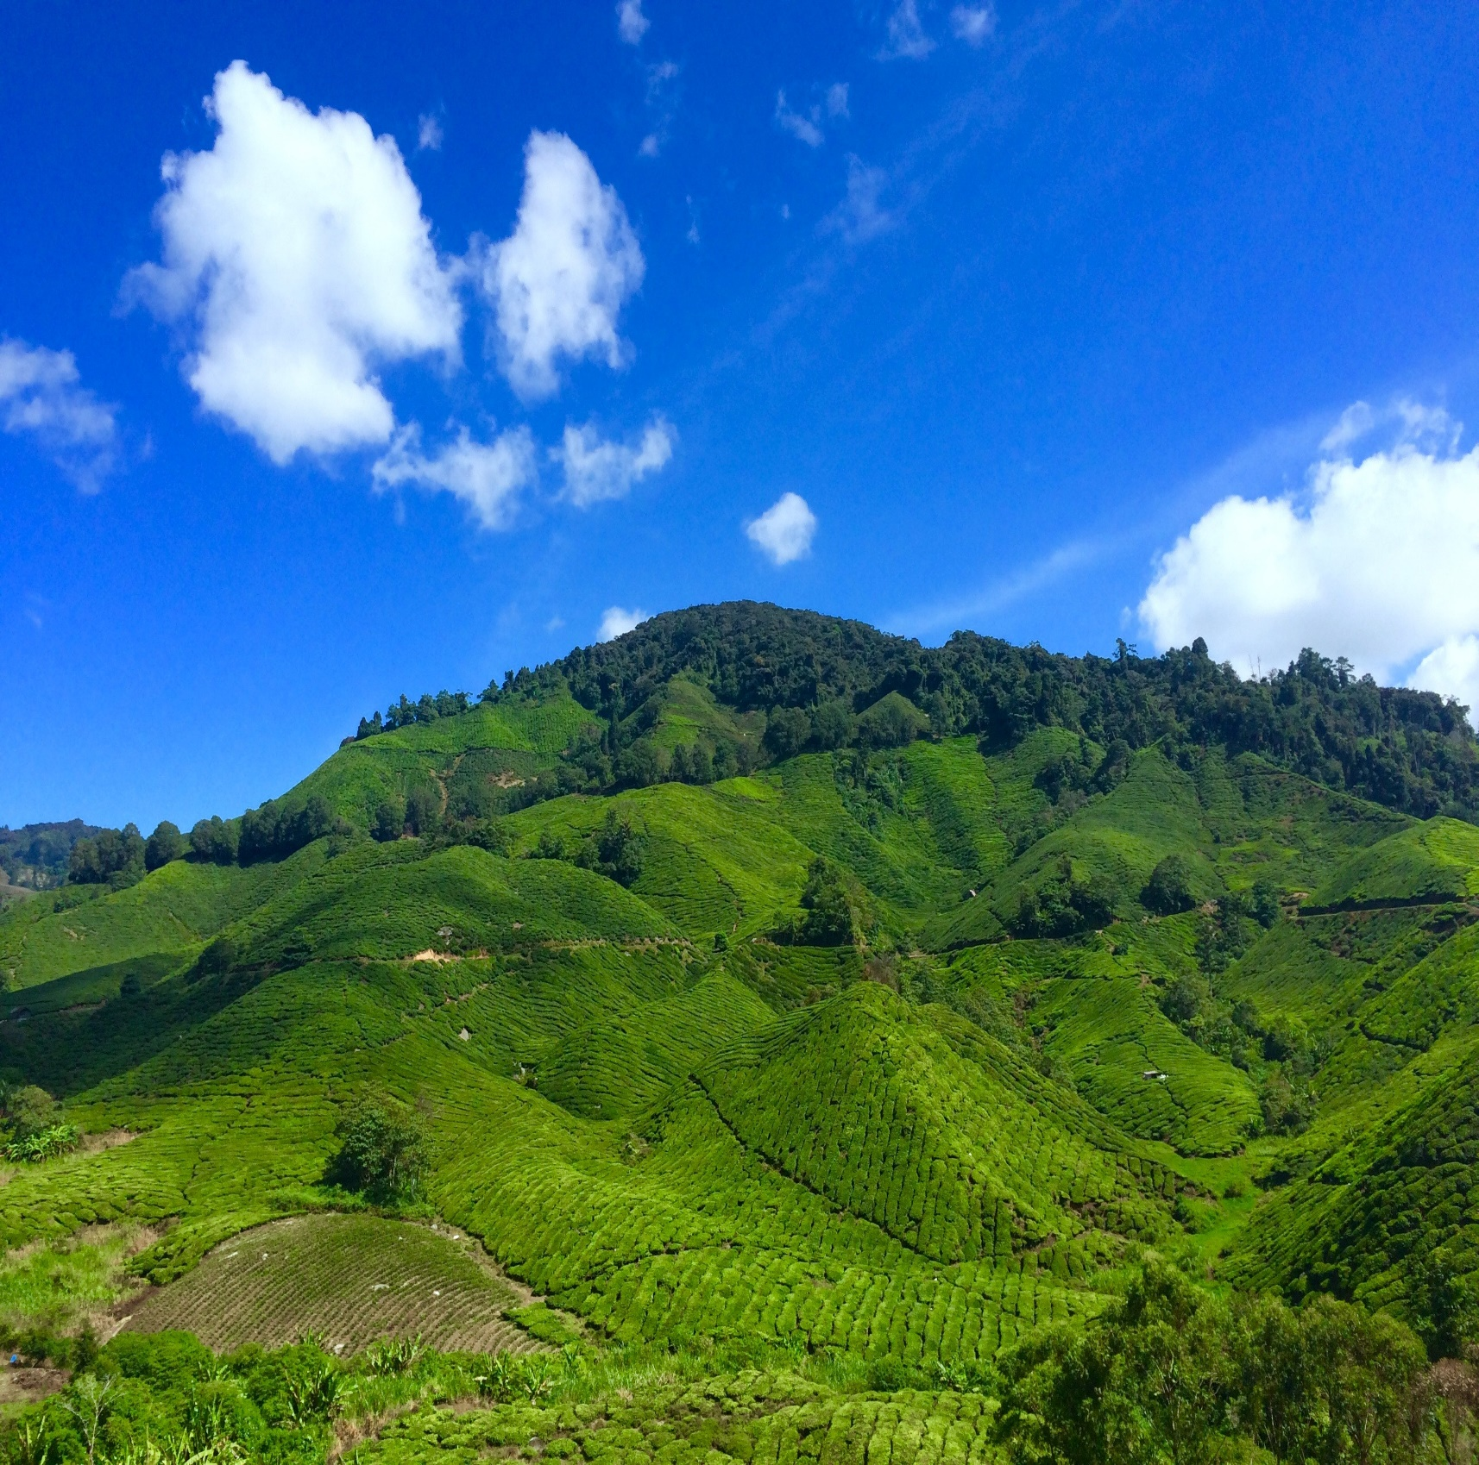
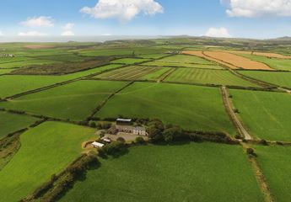
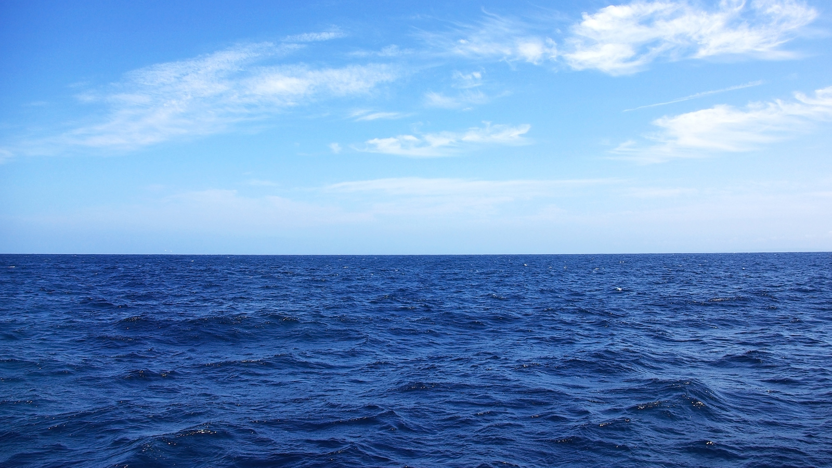
Where are wind turbines found?
High ground
Open fields
Offshore

Slide 39
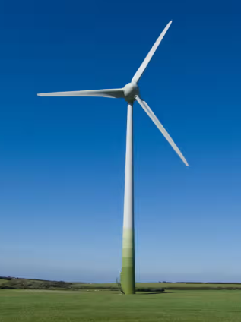
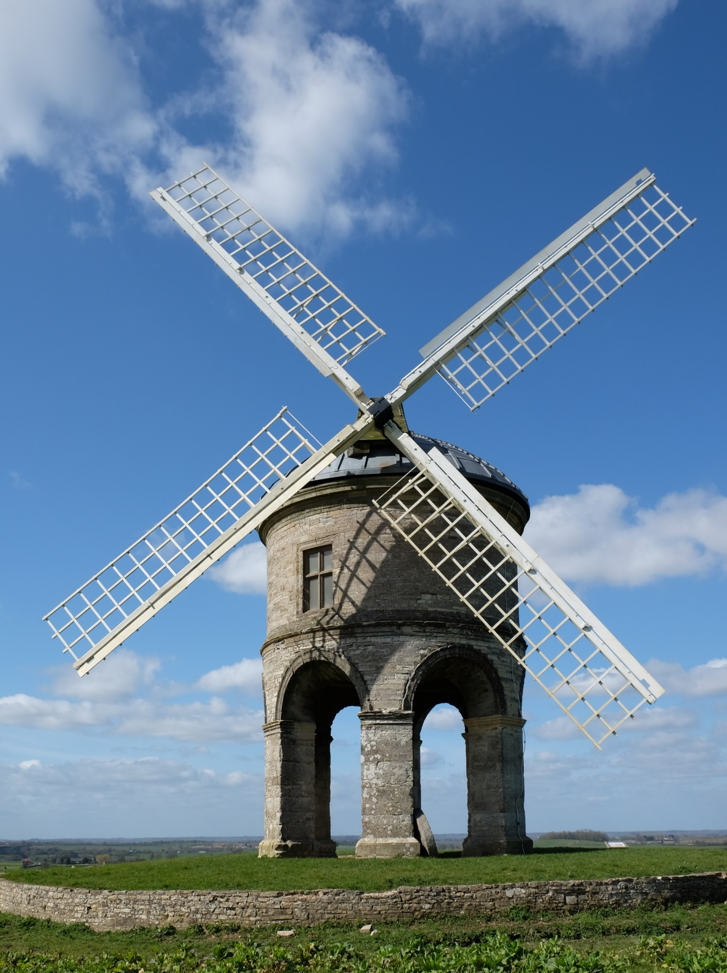



Which of these is a wind turbine?

Slide 40
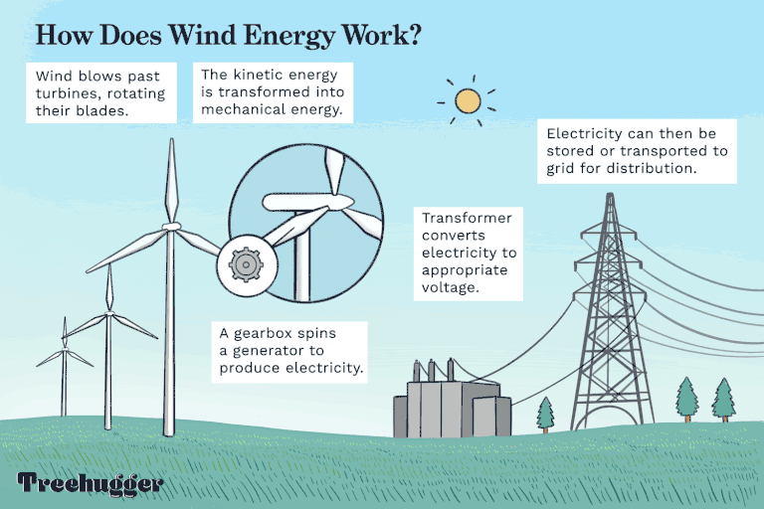

Slide 41
Advantages of Wind Turbines
Wind energy does not release carbon emissions.
Low operating costs, and manufacturing/installation costs are paid back quickly.
The wind power industry has created new jobs.
Minimal disruption to farmland operations.
Reduces our dependence on fossil fuels.
Disadvantages of Wind Turbines
Turbines can be noisy.
Upfront costs are expensive.
Limited to specific locations and landscapes.
Turbines can be dangerous to some wildlife.
Wind farms are said to ruin the landscape.

Slide 42
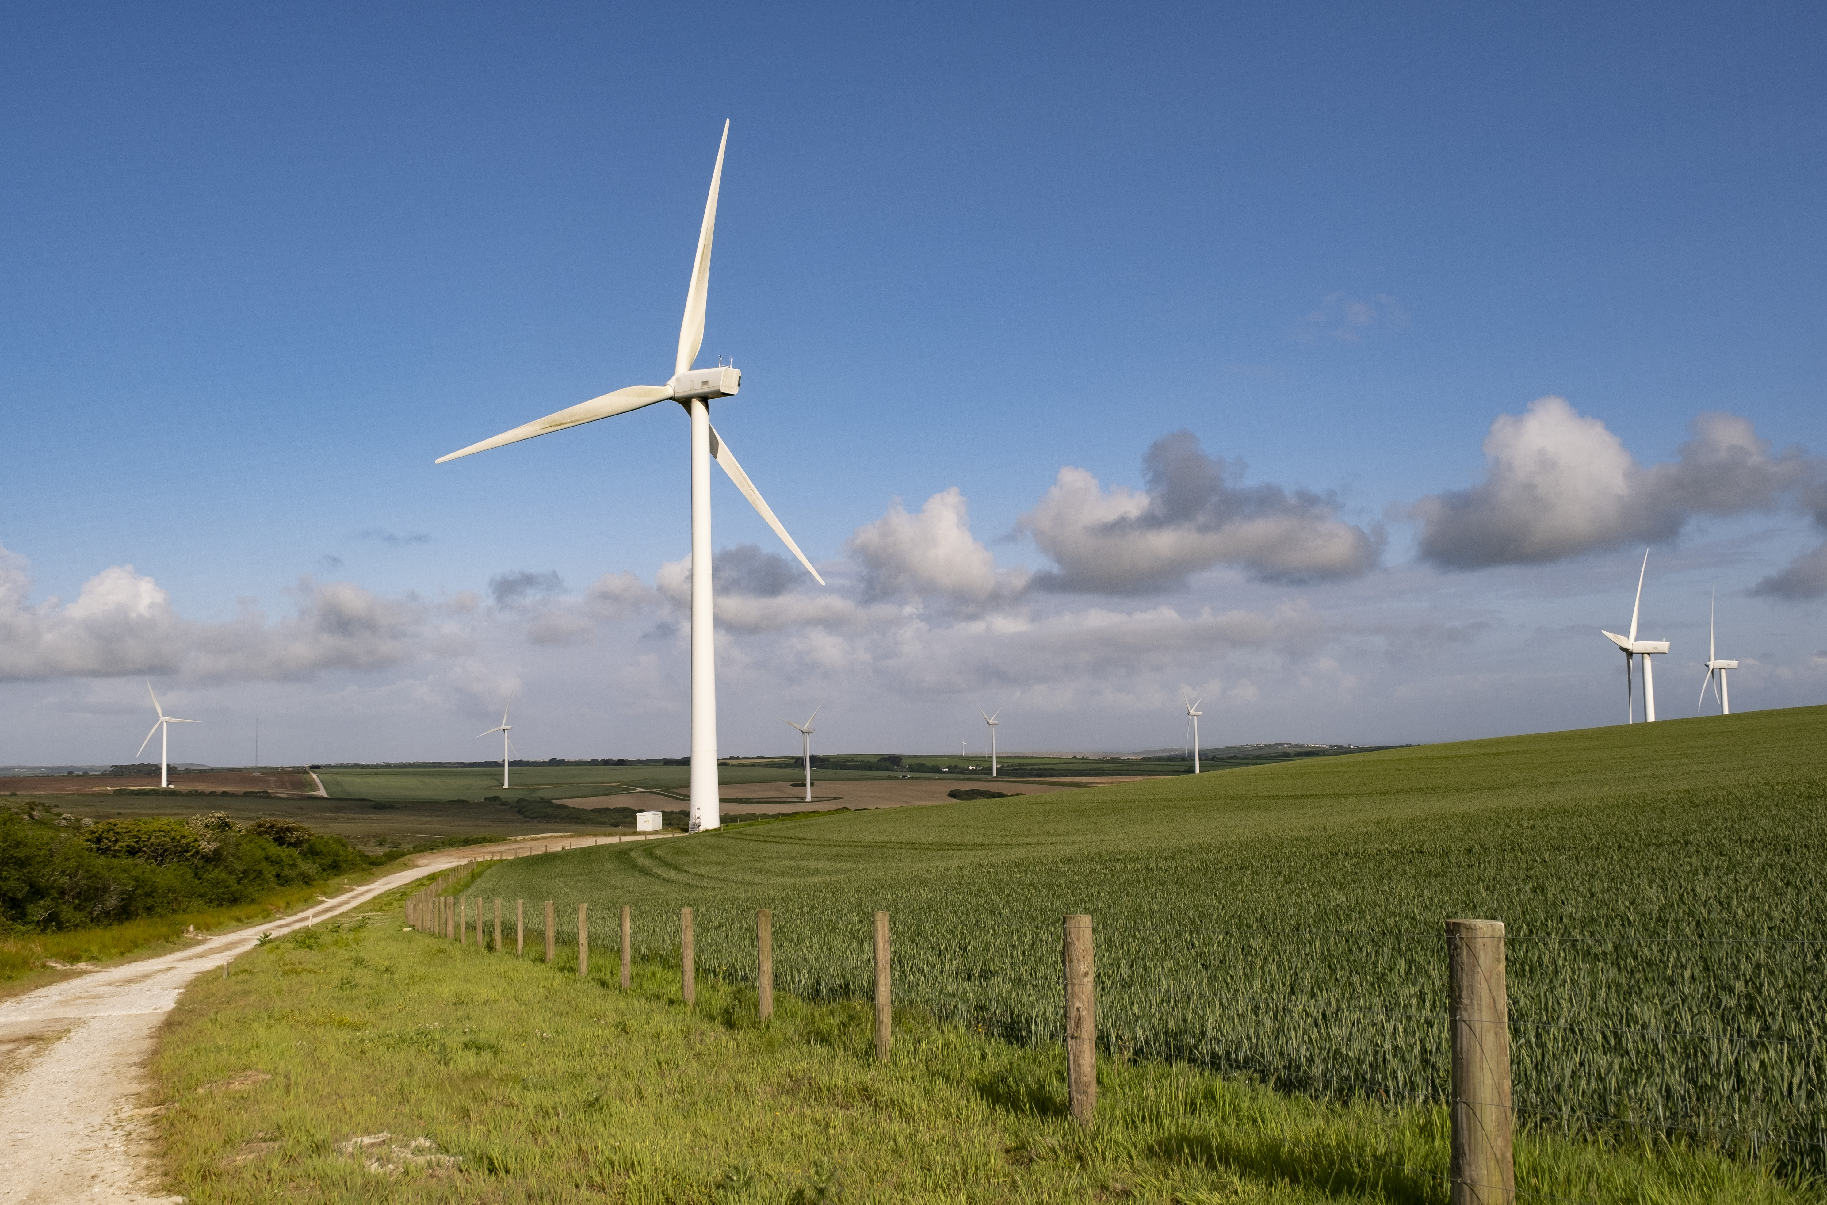
Activity: Create Your Own Paper Windmill
Instructions:
1. Fold a square piece of paper diagonally to create an 'X' crease.
2. Cut along the creases halfway to the center.
3. Fold every other corner toward the center and secure it with a paperclip.
4. Attach it to a pencil with string for a simple windmill!
Notes:
Now it’s time for you to make your own pinwheel.
We’re going to make our own paper windmills to see how wind energy works!
Here are the steps: Fold your square paper diagonally to make an 'X' crease.
Then, cut along the creases halfway to the centre. Fold every other corner toward the middle and secure it with a paperclip.
Once you’ve made your windmill, you can attach it to a pencil with string to make a simple wind turbine.
If we have a fan, we can use it to see how wind can make your windmill spin, just like a real wind turbine!

